Slide 1
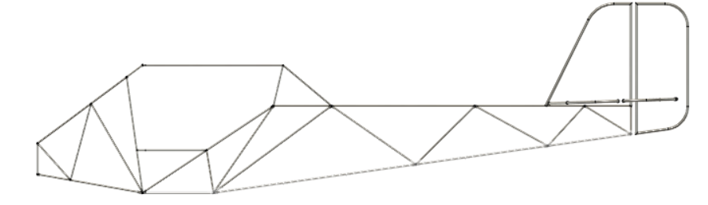
Fuselage Updates
Workshop 1/9/21

Slide 2
*Show the fusion here*

Slide 3
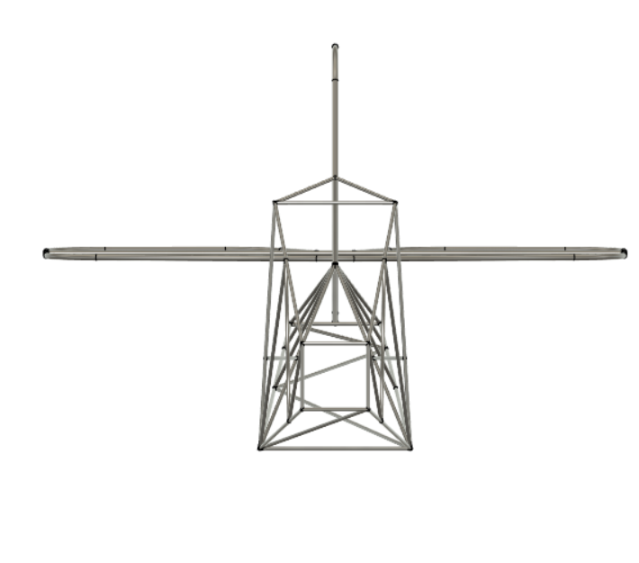
BIG CHANGE: Single beam top
Legal Eagle and Affordaplane do it, shouldn’t beam problem
Also square front gives great vision
Testing all this with sims!

Slide 4
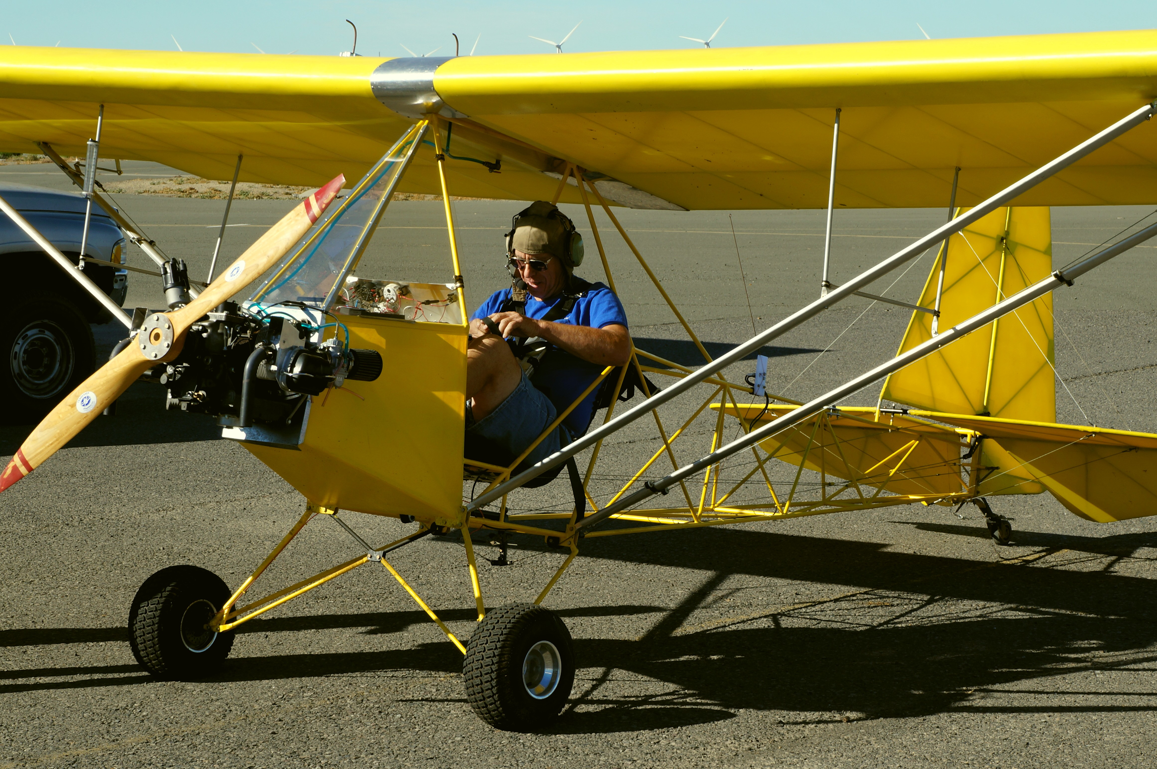
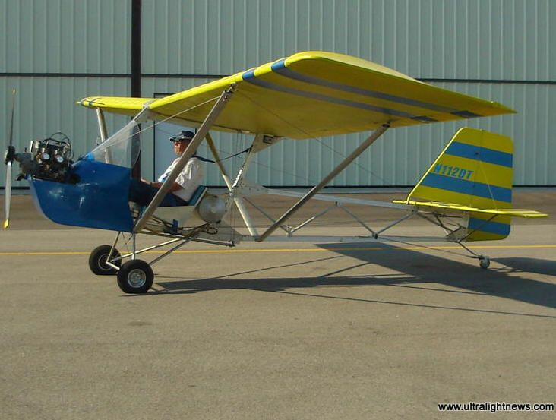
Example
Legal Eagle:
Affordaplane:

Slide 5
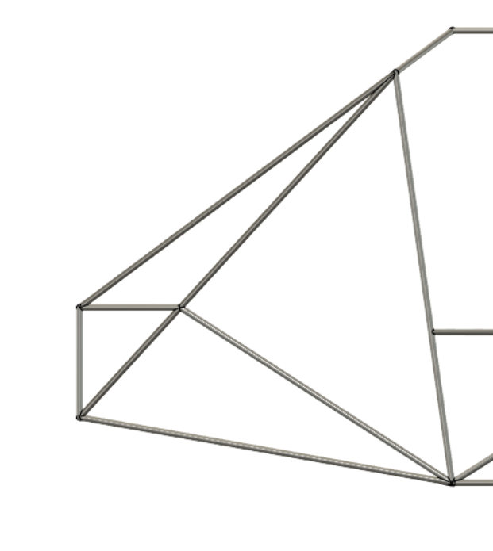
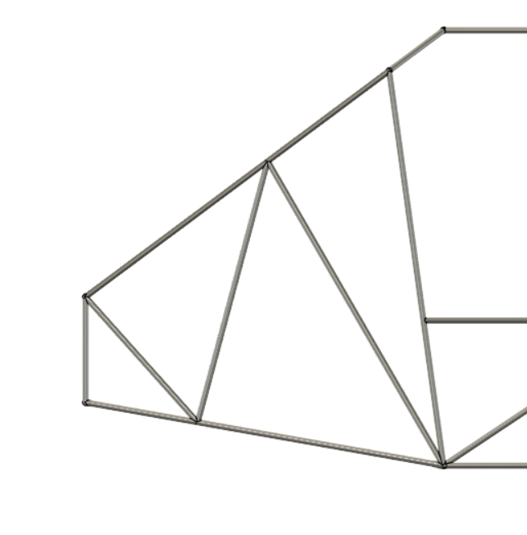
Nose
New:
Old:
Reason: triangles are always stronger!
More beams in front → better CG

Slide 6
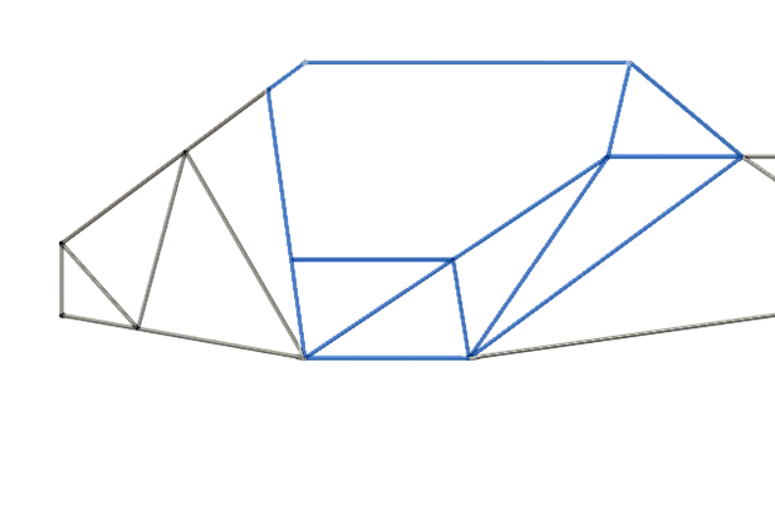
Cabin: Many new beams
Blue section should all reinforce the wing (hopefully)
Bob mackley: more reinforcements. So we did.
Triangles: good. If you see anything that looks sus pls let us know
Main thing here: pilot comfort

Slide 7
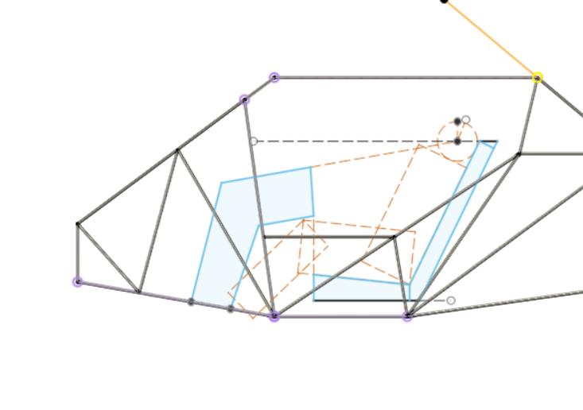
Pilot
We’re going to construct the fuselage out of cardboard to test the spacing

Slide 8
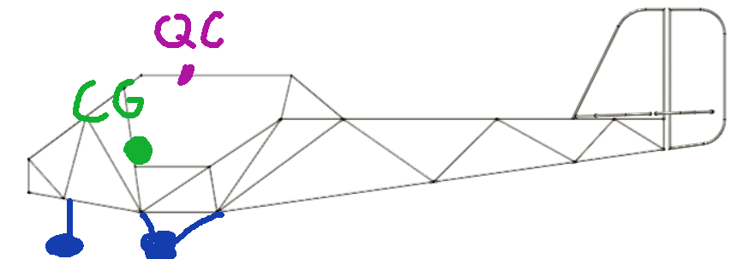
Landing Gear: Trike
Issue: pavement required for runway

Slide 9
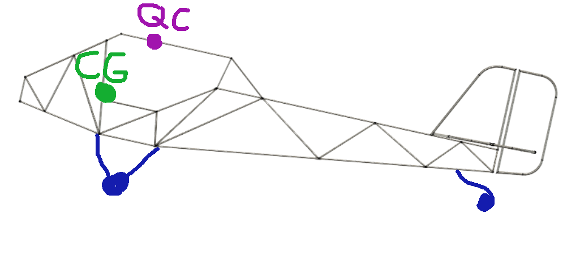
Taildragger:
Issue: Moment due to breaking during landing

Slide 10
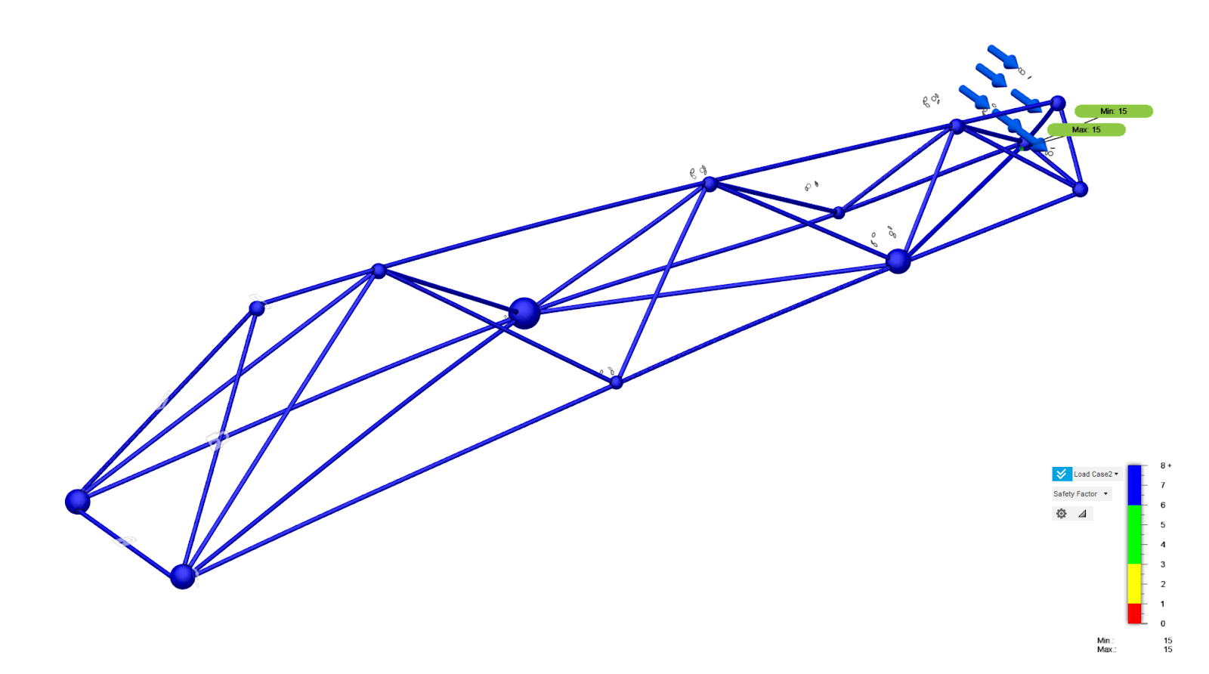
Empennage Diagonal:
Weight: 20 lb
Safety factor: 15
Pounds: simulating 60. Guessing around 30

Slide 11
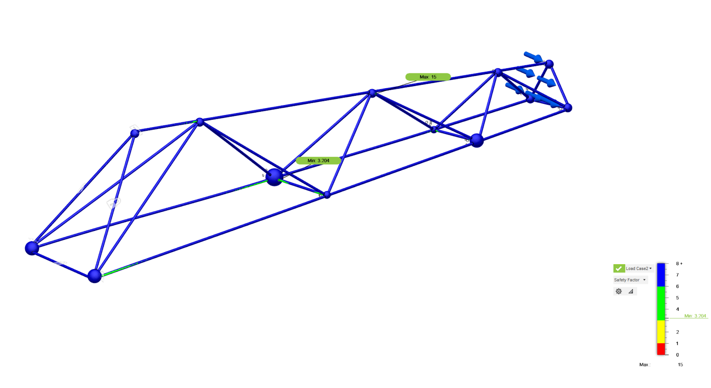
Empennage Horizontal:
Weight: 18 lb
Safety factor: 3
Pounds: simulating 60. Guessing around 30
Safety factor only needs to be 1.5 bc all forces already have a safety factor of 2
3 on wing

Slide 12
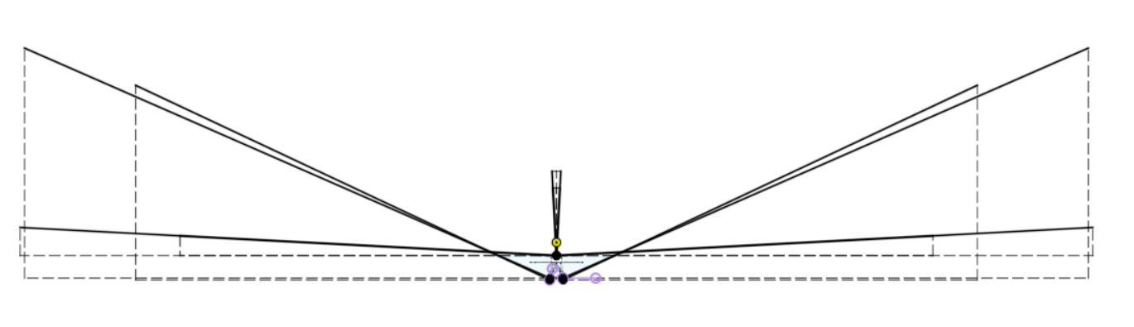
Simulations
These are our forces:
Every inch: a pound. Crazy. So we have to simulate

Slide 13
Simulation Tutorial Time! Yay!

Slide 14
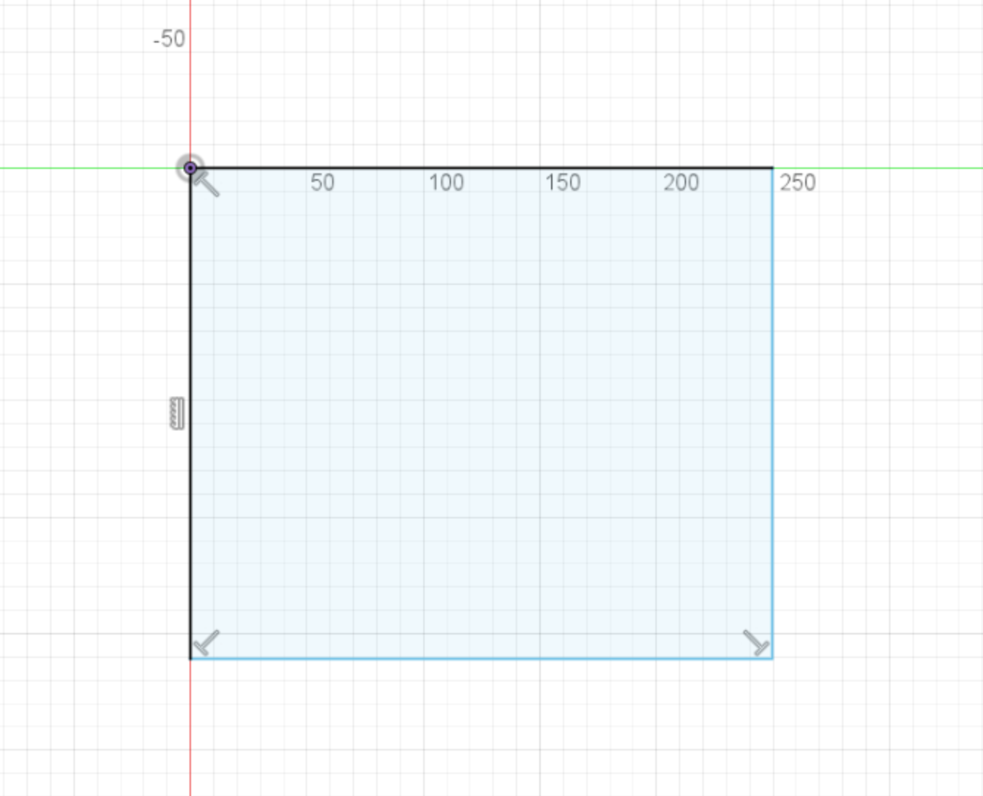
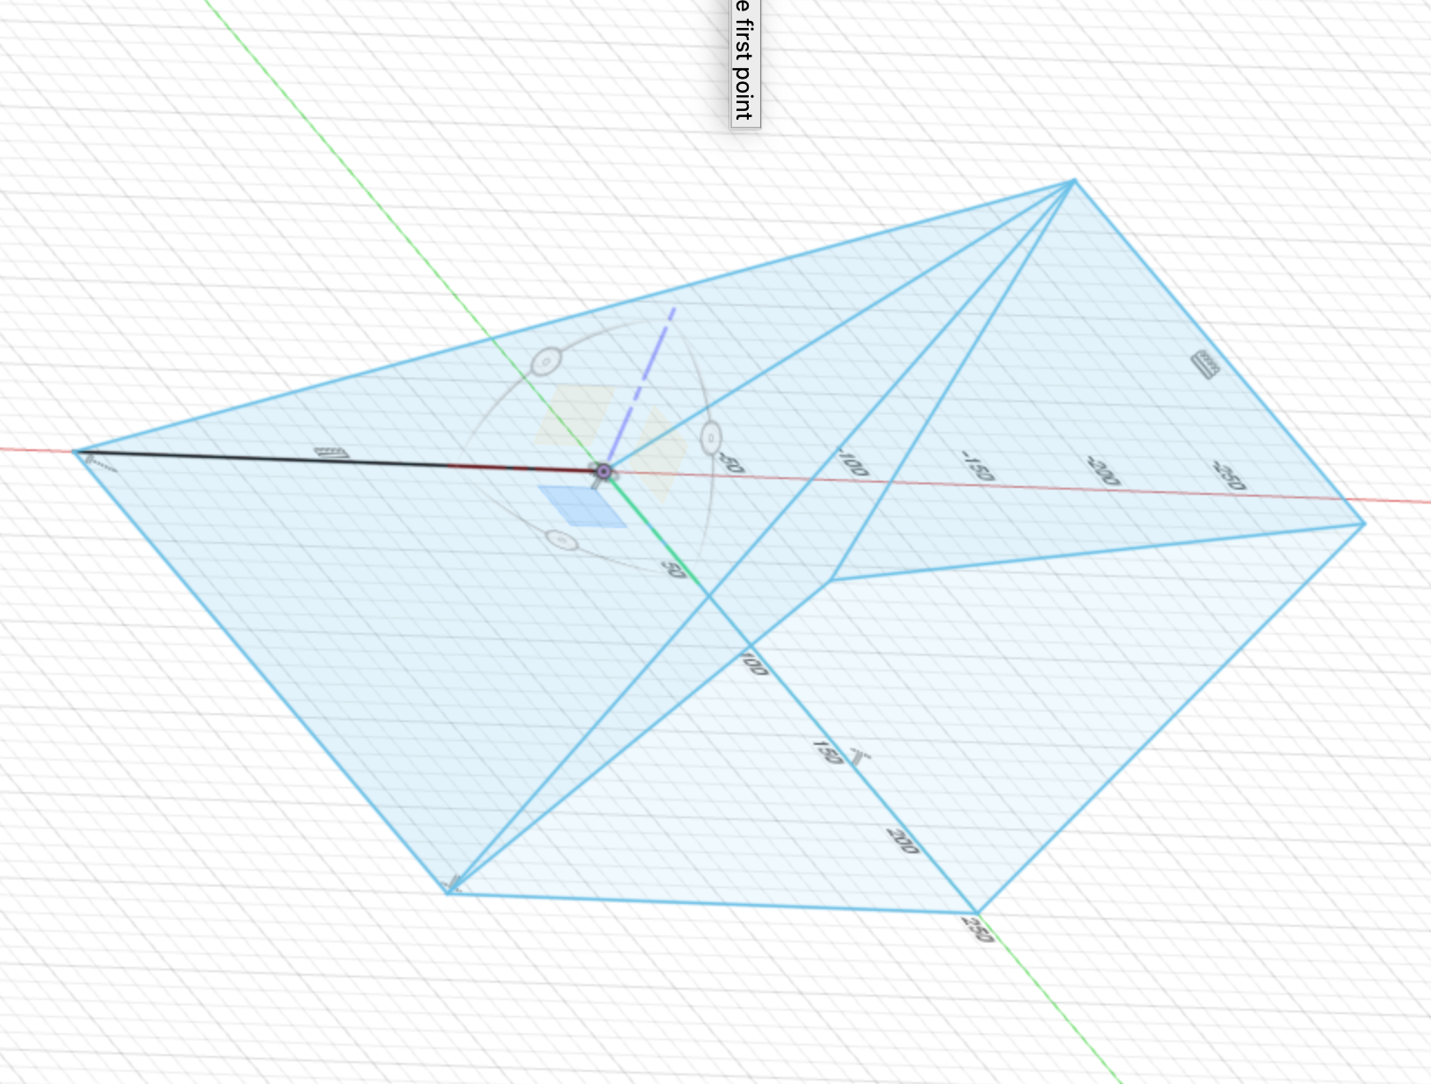
Start a sketch in Fusion
Sketch a shape
Create a structure
You can 3d sketch by clicking on one of the yellow square ato go to another plane.
Finish the sketch

Slide 15
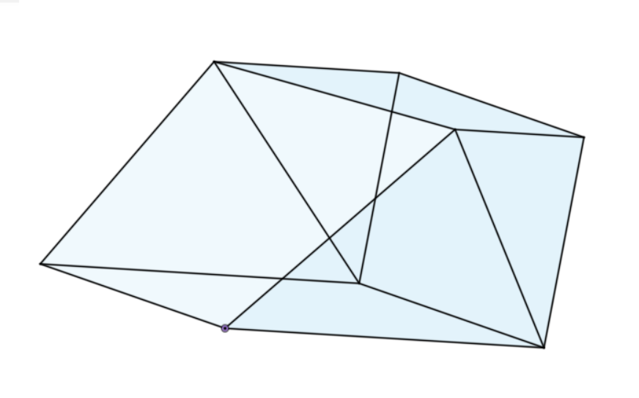
Create your funky shape
At least 4 beams coming together
Funky non-right angles
Angles must be greater than 25 degrees (as it will be in real life)
Note: save it under FCA>Simulations>Practice
You can create your own folder if you want

Slide 16
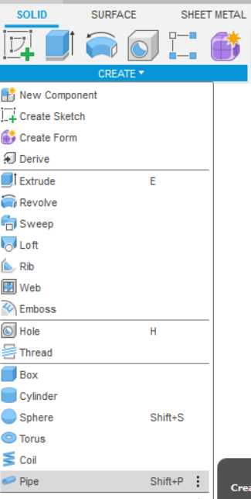
Pipe Feature
All profiles will be:
0.625 OD
0.035 Wall
Hollow
Tip:
Think about how YOU would weld it. What would you do first? If you get a bad weld: re-order it!

Slide 17
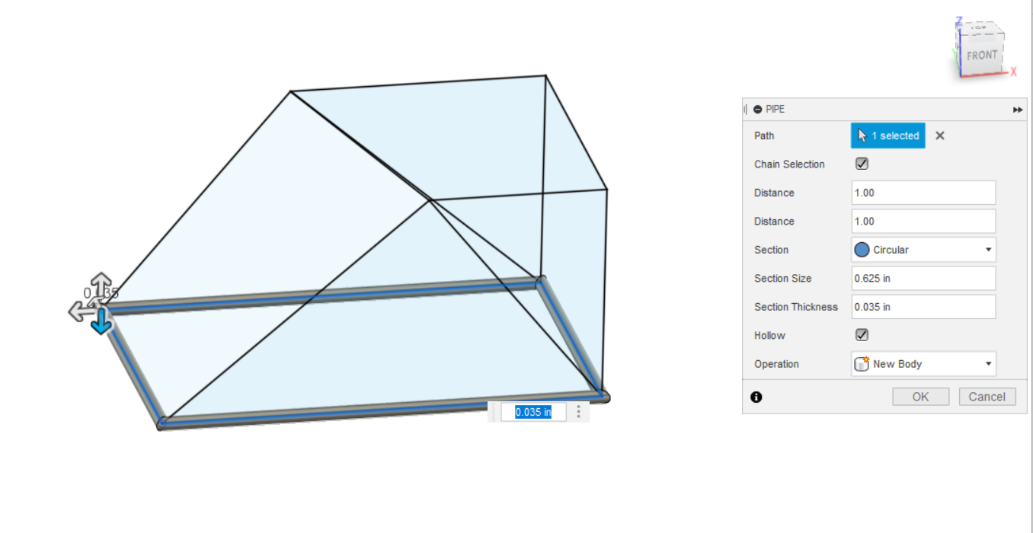

Slide 18
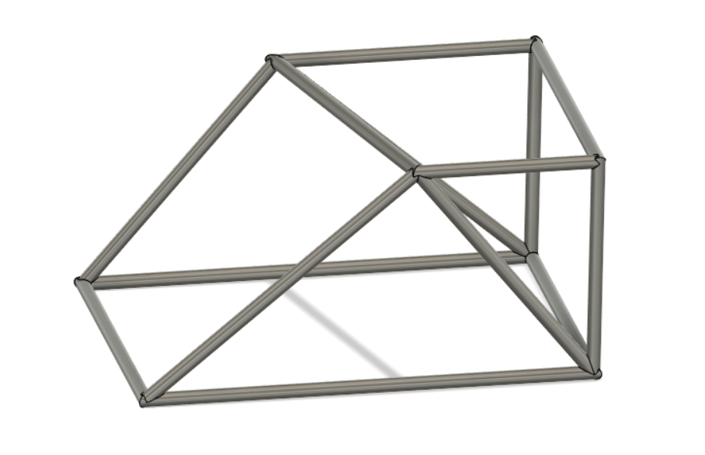
Do all the lines → pipes

Slide 19
Record of Shapes + forces
Name + pic of shape:

Slide 20
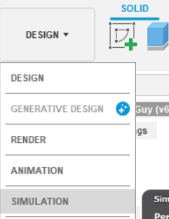
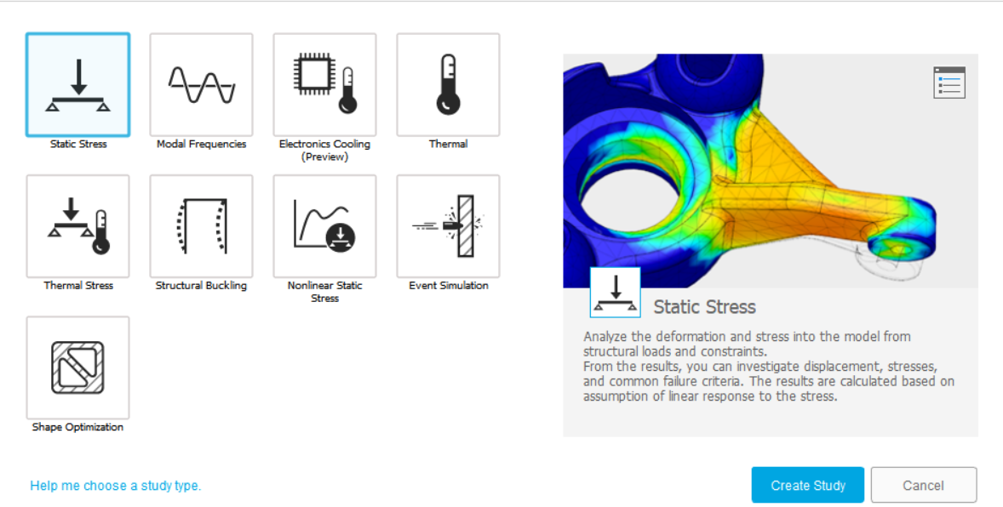
Go to Simulation tab
Choose “Static Stress”

Slide 21
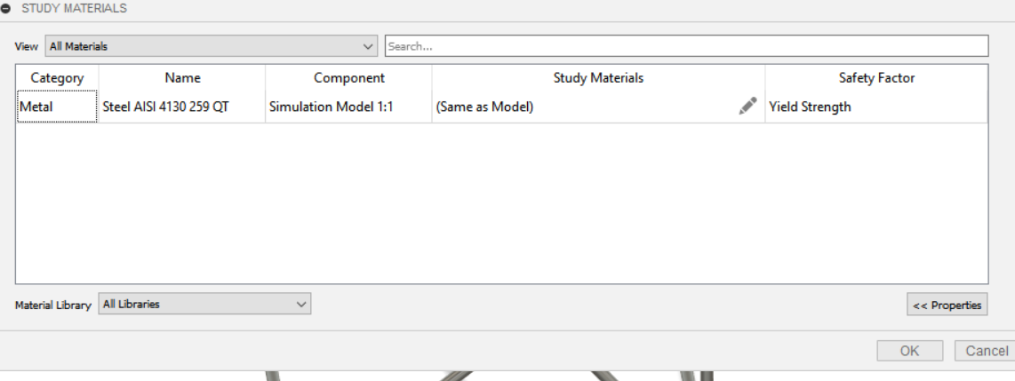
Set your material
4130 is great! Please do that because that’s our fuselage material!

Slide 22
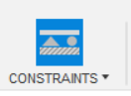
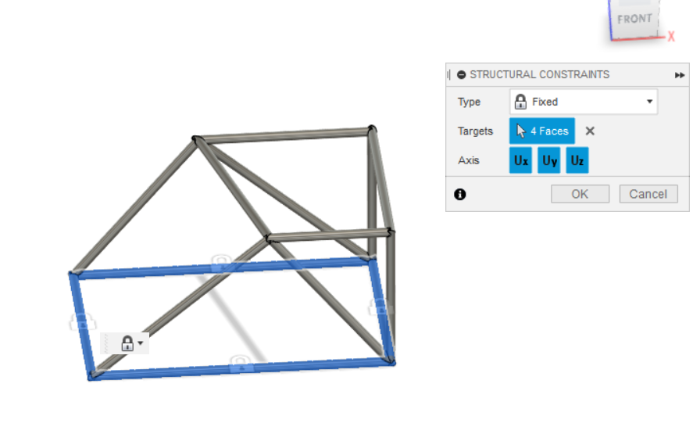
Constraints
These are immovable!
They will get some forces. Choose what you’d like

Slide 23

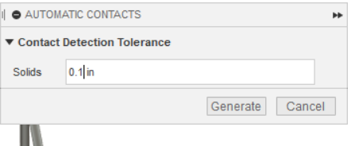
Contacts
Tell the computer that it’s one body!
Usually you should be find if you used “pipe” correctly, but just in case:
^ automatic
Right: manual. When you manually say “these two things are one thing”

Slide 24

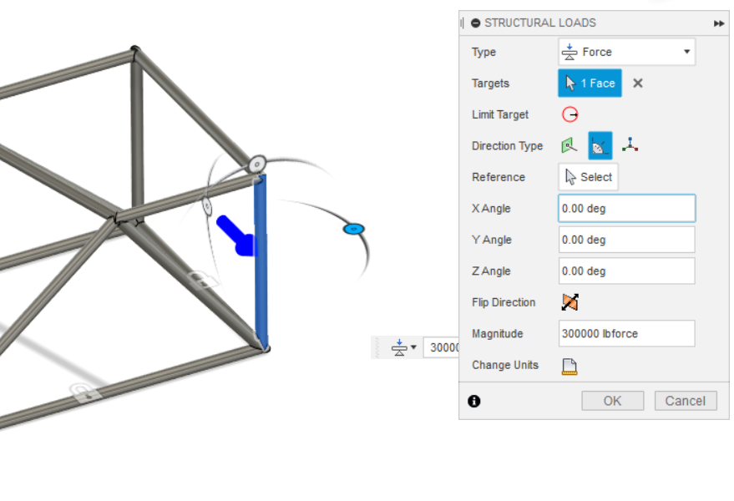
Loads
You can choose entire beams:
(yes that’s a lot of zeros for the force.
No it will not be able to take this)

Slide 25
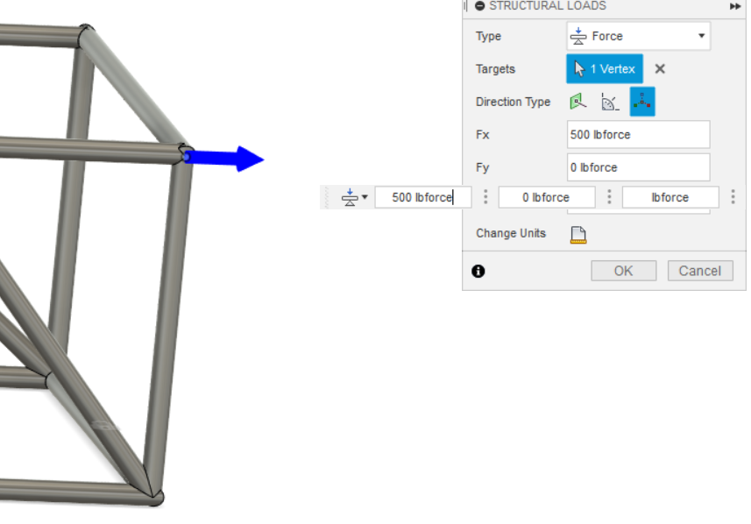
Loads
You can do it on joints too:
You can do x,y,z or through angles

Slide 26

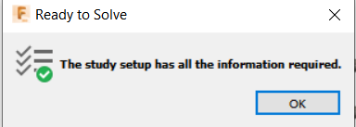
If you’re good to go:
Click the check green check mark guy

Slide 27
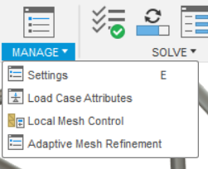
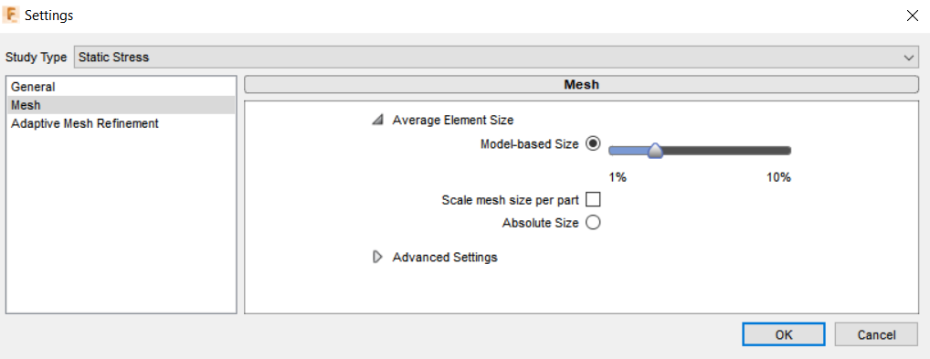
Meshes
Manage> Settings
Make your mesh as small as your computer can handle. My i7 16 gb RAM takes absolute size 0.1 in. or 1%.
Depends on how
Small your model
is

Slide 28
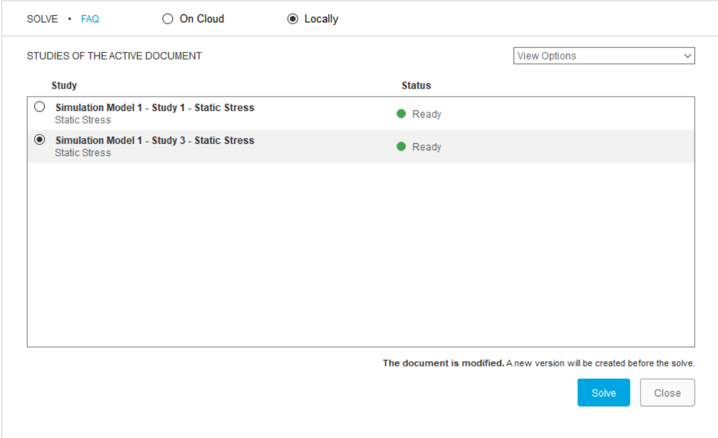
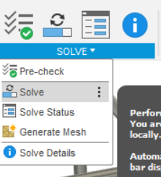
Alrighty, now that you have your mesh settings → hit solve!
This is going to take your WHOLE computer. Get off zoom and rejoin once it’s completed. If it’s taking more than 20 mins then come back onto the zoom. We’ll troubleshoot

Slide 29
Record of force + result:

Slide 30
Typical Problems with sims

Slide 31
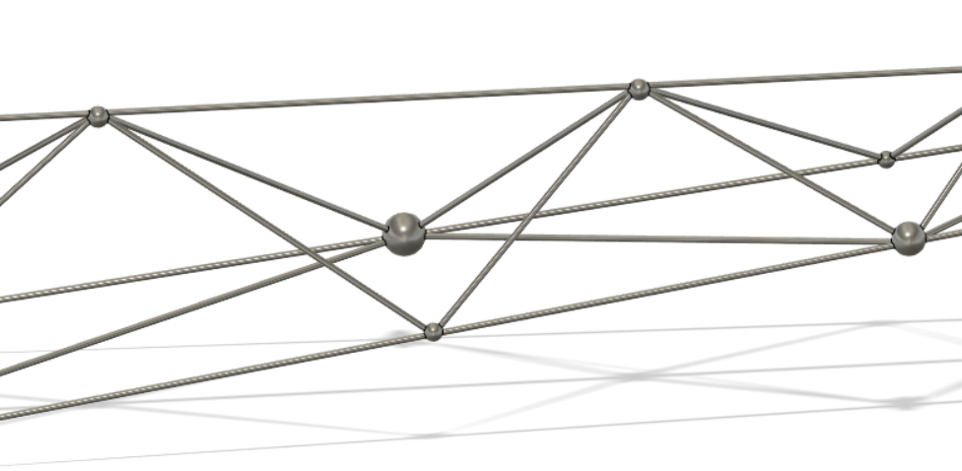
Joints
The welds are only as good as we make them → simulations won’t help
If they’re super the problem: add little spheres

Slide 32
Mesh
Sometimes it self intersects:
Matt draw pic, then i’ll screenshot and put on this slideshow
Solution: make mesh finer.

Slide 33
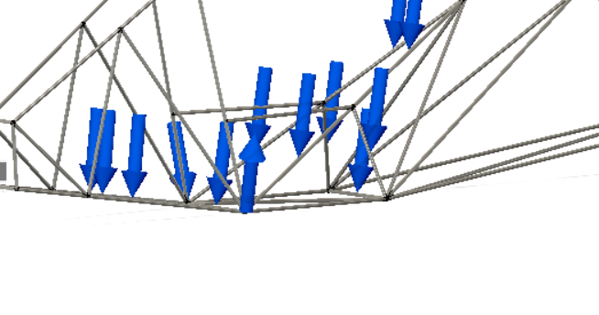
Fail at Solution
Lol good luck. None of us have been able to solve that.
You might need to add less forces. That sorta worked for us.
= fusion mad

